Slide 1

Blockchain, Cryptocurrency & Data Science
Key lessons & takeaways while addressing important questions of the day
By Matthew Thomas

Slide 2

About Me
Current employment: Full time home health PT in Las Vegas, NV
PT school at Washington University in St Louis (MSPT)
BS in Biology from Utah State University
Long time interest in technology and data leading to entering the world of data science
Data science aspirations/interests: health care, cryptocurrency, blockchain, finance, venture capitalism, startups, serial entrepreunism, running, human behavior and performance

Slide 3
Project Introduction
Why blockchain and cryptocurrency as a project
Growing popularity
Expanding possibilities
Pandemic effect
Progress of the technology world everywhere

Slide 4

What is Blockchain?
“A list of transactions anyone can view and verify”
Nearly all cryptocurrencies use blockchain technology
“Value” can be transferred online
Every link on the chain is a chunk of transaction data
Like a ship’s anchor
Other uses: medical records, contracts, voting results
This Photo by Unknown Author is licensed under CC BY

Slide 5
Advantages of Blockchain
Global
Increased privacy
No need to disclose any sensitive info to complete transaction
No need for middleman like a bank or credit card company
Transparency of transactions in a distributed ledger
Provides opportunities for all from all levels

Slide 6
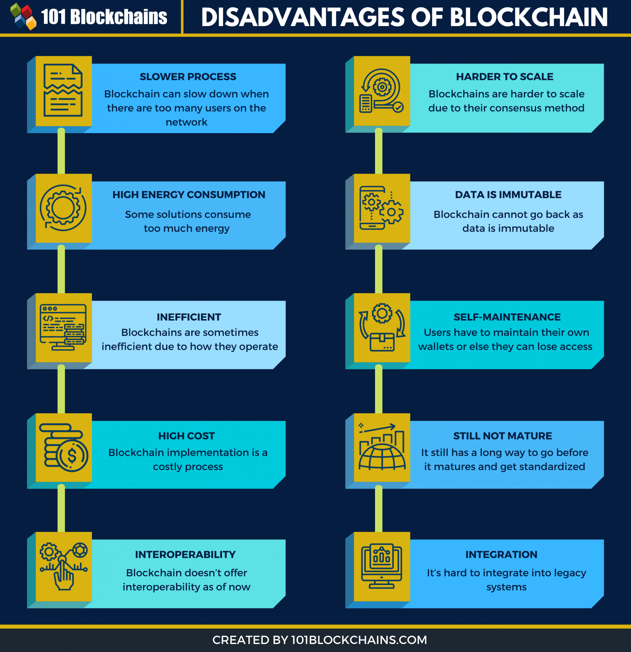
Disadvantages of Blockchain

Slide 7
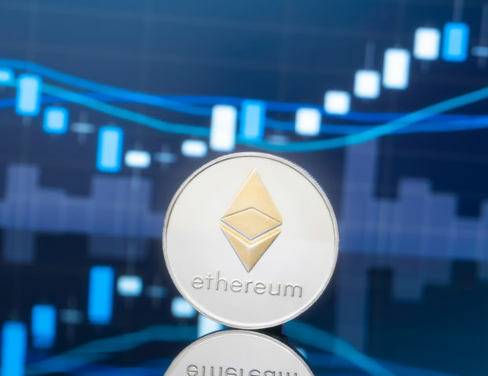

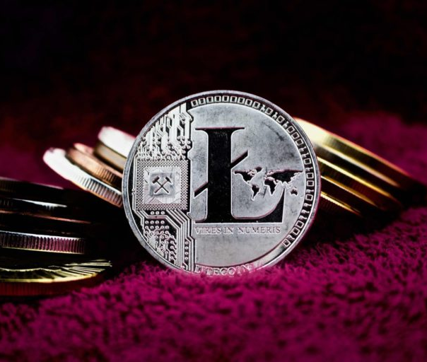
Cryptocurrency
Digital money in a digital wallet
Thousands of cryptocurrencies throughout the world
Bitcoin, the first, the biggest, the most well known
Cryptocurrencies being accepted by more and more businesses and entire countries
Decentralized

Slide 8

How can blockchain & data science rule the world?
“For starters, both blockchain and data science deals with data — data science analyses data for actionable insights, while blockchain records and validates data. Both make use of algorithms created to govern interactions with various data segments. A common theme which you will soon notice is this, “data science for prediction; blockchain for data integrity.” How Blockchain Will Disrupt Data Science: 5 Blockchain Use Cases in Big Data | by Salih SARIKAYA | Towards Data Science
Both fields can build on their common goals and work to improve data usage, security and benefits

Slide 9
WIIFM: What’s In It For Me?
Investing
Inflation
Income
Inevitable

Slide 10
Evaluation Questions
How has the historical prices of various cryptocurrencies changed over time?
How do price fluctuations of currencies correlate with each other?

Slide 11
Data sets in the world of cryptocurrency
Lots and lots of statistical and historical data
Not much categorical data looking at factors (dependent variables) affecting the prices of cryptocurrencies
Many opportunities for data scientists in the world of blockchain and cryptocurrency

Slide 12
The Process: Wrangling, Analyzing, & Visualizing
Selected data sets were wrangled
Analysis completed to answer evaluation questions
Visualizations/graphs made to tell the story

Slide 13
THE RESULTS
How has the historical prices of various cryptocurrencies changed over time?
Most widely known, trusted and stable cryptocurrencies have essentially increased over time
Expected fluctuations and reactions to external factors have been evident, but need further data collection and analysis

Slide 14
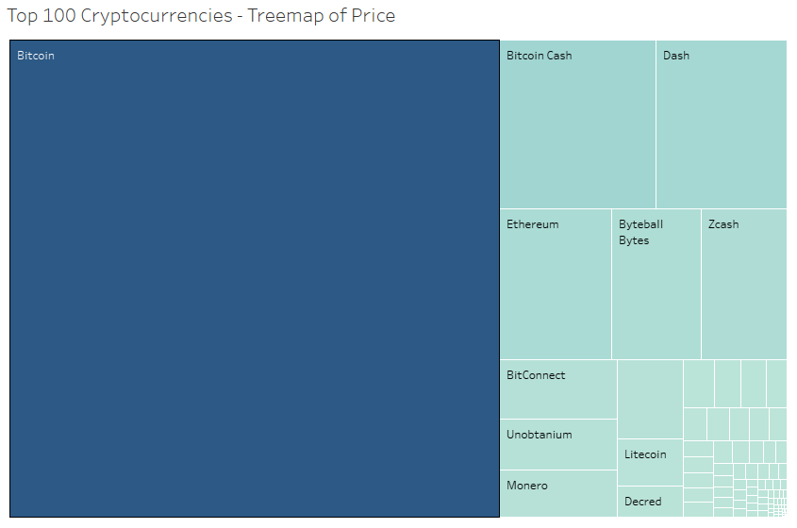
Top 100 Cryptocurrencies & Price

Slide 15
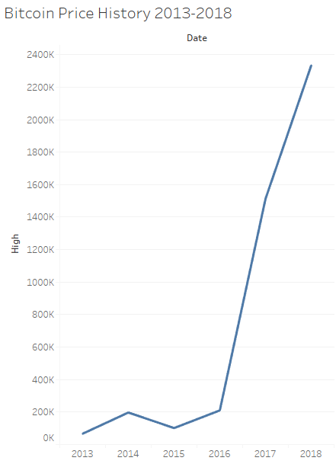
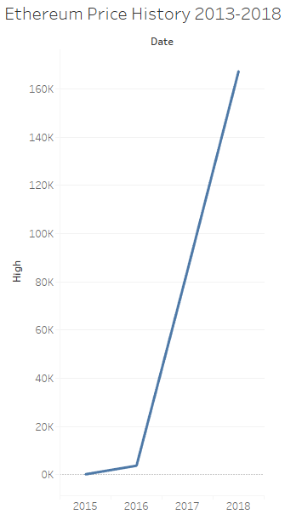
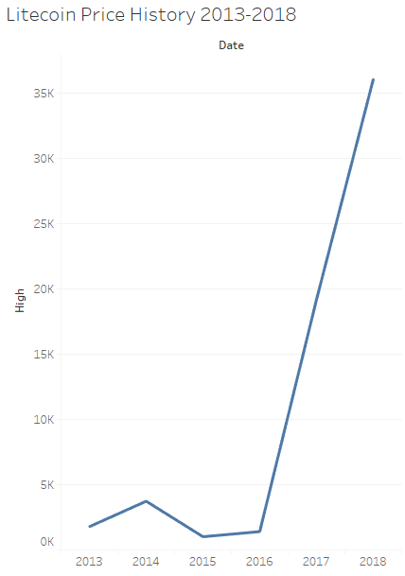
Price History of 3 Popular Cryptos

Slide 16
MORE RESULTS
How do price fluctuations of currencies correlate with each other?
Most cryptocurrencies seem to closely follow the course of Bitcoin on a daily, weekly, monthly basis

Slide 17
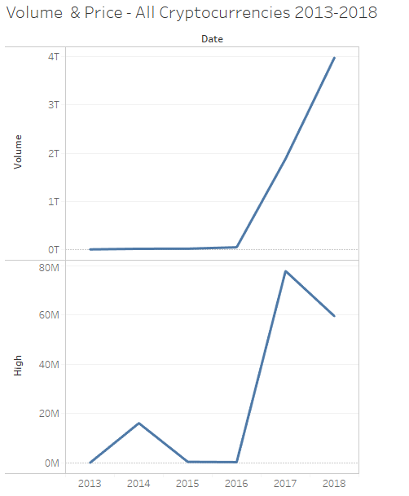
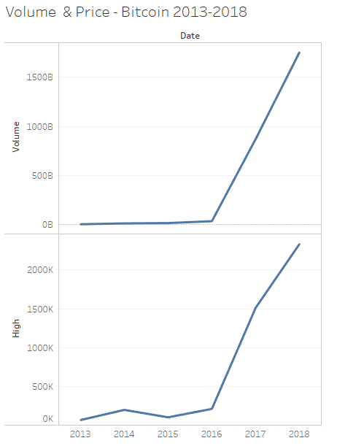
Volume & Price Cryptocurrency Comparisons All Cryptos vs BTC

Slide 18
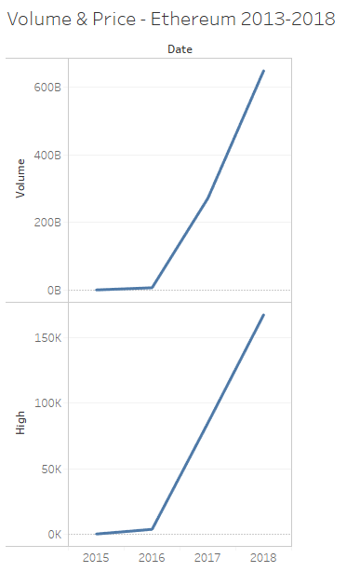
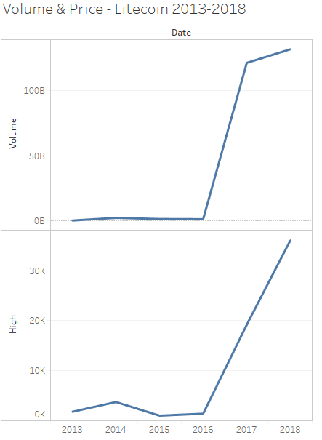
Volume & Price Cryptocurrency Comparisons Ethereum vs Litecoin

Slide 19
Summary
Cryptocurrency prices have overall steadily increased since the beginning of the cryptocurrency market
Cryptocurrencies have a definite correlation to one another and in particular follow the trends of Bitcoin more than any other cryptocurrency

Slide 20
Conclusions
These results appear to concur with what is widely reported and confirmed with data analysis
Data scientists need to become more involved in the cryptomarket to better understand the effect that the following have on cryptocurrency:
Legislation related to cryptocurrency nationally & globally
Central banks and individual countries developing their own cryptos
Energy costs for crypto mining
Calling all data scientists!

Slide 21
Sources for Information:
“What is Blockchain?”, https://www.coinbase.com/learn/crypto-basics/what-is-a-blockchain?utm_creative=&cb_device=c&cb_placement=&cb_country=us&cb_city=open&cb_language=en_us&msclkid=beb6d5b618b71ef6300eb57d5cf976bb&utm_source=bing&utm_medium=cpc&utm_campaign=rt_p_us_w_m_acq_bin_sea_non_Blockchain&utm_term=%2Blearn%20%2Babout%20%2Bblockchain&utm_content=Blockchain-Learn%20About
all_currencies.csv data set, https://www.kaggle.com/taniaj/cryptocurrency-market-history-coinmarketcap
100 List.csv data set, https://www.kaggle.com/natehenderson/top-100-cryptocurrency-historical-data
gemini_*.csv data sets (3), https://www.kaggle.com/roopahegde/cryptocurrency-timeseries-2020
coin_*csv data sets (3), https://www.kaggle.com/sudalairajkumar/cryptocurrencypricehistory
How Blockchain Will Disrupt Data Science: 5 Blockchain Use Cases in Big Data | by Salih SARIKAYA | Towards Data Science

Slide 22
Sources for Information:
Effect of blockchain on programming languages especially python - Chase2Learn
https://fortunly.com/statistics/blockchain-statistics/
https://www.cnbc.com/2021/06/09/el-salvador-proposes-law-to-make-bitcoin-legal-tender.html
https://medium.com/covesting/factors-affecting-the-cryptocurrency-market-bd791b3c72dd
https://thefrisky.com/how-many-cryptocurrencies-are-out-there/
Why Are Central Banks Trying To Create Their Cryptocurrencies? | by Yağmur Şahin | DataBulls | Medium
https://101blockchains.com/disadvantages-of-blockchain/
FIND A FEW MORE DETAILS AT SPMOG/Project-Blockchain: Final Project for Data Science Program (github.com)

Slide 23

Thank you to all who have been part of my data science journey!

Slide 24

This Photo by Unknown Author is licensed under CC BY-NC-ND

